Slide 1
Hot Standby Router Protocol (HSRP) USING CISCO PACKET TRACER
GROUP MEMBERS-
SHUBHI GUPTA (RA1811004010426)
VANSHIKA JUSTA (RA1811004010442)
SAGNIK ROY (RA1811004010453)

Slide 2
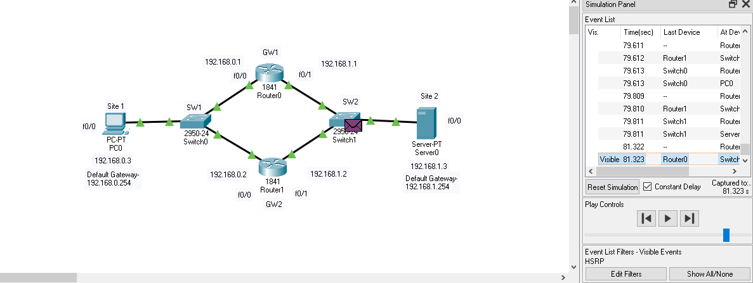
WHAT IS HSRP?
Hot Standby Router Protocol (HSRP) is a CISCO proprietary protocol, which provides redundancy for a local subnet. In HSRP, two or more routers gives an illusion of a virtual router.
HSRP allows you to configure two or more routers as standby routers and only a single router as active router at a time. All the routers in a single HSRP group shares a single MAC address and IP address, which acts a default gateway to the local network. The Active router is responsible for forwarding the traffic. If it fails, the Standby router takes up all the responsibilities of the active router and forwards the traffic.

Slide 3
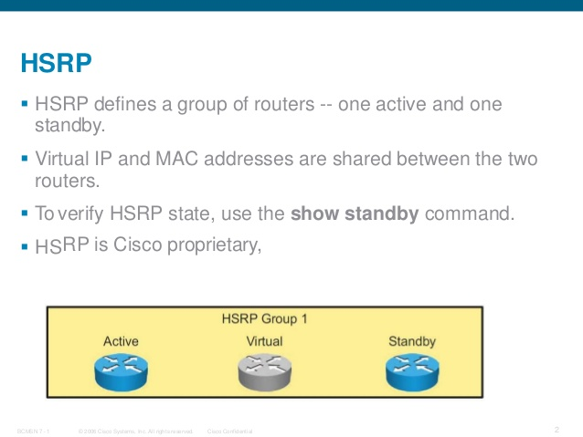
Some important terms related to HSRP-
Virtual IP : IP address from local subnet is assigned as default gateway to all local hosts in the network.
Virtual MAC address : MAC address is generated automatically by HSRP. The first 24 bits will be default CISCO address (i.e. 0000.0c). The next 16 bits are HSRP ID (i.e. 07.ac). The next 8 bits will be the group number in hexadecimal. e.g- if the group number is 10 then the last 8 bits will be 0a. Example of virtual MAC address –
0000.0c07.ac0a
Hello messages : Periodic messages exchanged by active and standby routers. These messages are exchanged after every 3 seconds telling the state of router.
Hold down timer : Its default value is 10 seconds i.e roughly 3 times the value of hello message. This timer tells us about the router that how much time will the standby router waits for hello message if it is not received on time. Note- If the active router fails then the standby router will become the active router.
Priority : By default, the priority value is 100. It is helpful when the active router comes back after falling down, we can change the priority of standby router (which has become the active router after the original active router is down) to less than 100 therefore it again becomes standby router.
Preempt : It is a state in which the standby router automatically becomes the active router.

Slide 4
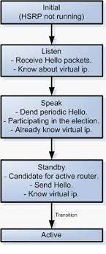
HSRP States-
When in operation, HSRP devices are configured into one of many states:
Active – This is the state of the device that is actively forwarding traffic.
Init or Disabled – This is the state of a device that is not yet ready or able to participate in HSRP.
Learn – This is the state of a device that has not yet determined the virtual IP address and has not yet seen a hello message from an active device.
Listen – This is the state of a device that is receiving hello messages.
Speak – This is the state of a device that is sending and receiving hello messages.
Standby – This is the state of a device that is prepared to take over the traffic forwarding duties from the active device.

Slide 5
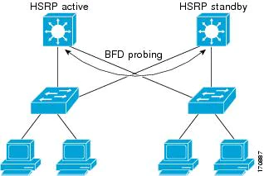
ADVANTAGES AND DISADVANTAGES-
ADVANTAGES-
Used for backup process
No need to change default gateway every time
No fault tolerance
DISADVANTAGE-
One of the gateways always sits idle until the active device fails. This wastes the forwarding potential of this second device; to solve this problem, utilize multiple HSRP groups.

Slide 6
HSRP NETWORK

Slide 7
Configuring HSRP-
Before the HSRP (Hot Standby Router Protocol) configuration, we must prepare our topology. We will change the router names and we will assigned the ip addresses of the router interfaces.
For the left side of the topology, we will use 192.168.0.3 network and for the right side, we will use 192.168.1.3 network. All the interfaces connected to the layer 2 switch will be assigned with the ip addresses related to its connected port. For example the fa0/0 interface of the Site1 router will be assigned the ip address 192.168.0.3 and the GW1’s and GW2’s fa0/0 ip addresses will be 192.168.0.1 and 192.168.0.2 orderly.
After interface configuration, we will configure a static route on each Site1 and Site2. In this static route we will use two virtual ip addresses that we will explain in this article. This virtual addresses will be 192.168.0.254 and 192.168.1.254.
Routers R0 and R1 are configured with priorities of 11 and 10, respectively. The default priority is 100. The higher priority will determine which router is active. The configuration of Router A is displayed. A similar configuration is required on Router B. Now router A is in active state and B in standby state based on highest priority value. If R1 has the same priority as R0, the router with highest ip address becomes active while the router with second highest ip becomes standby.

Slide 8
Now our configuration is ready to HSRP configuration. Let’s start on one side(left) on GW1 and GW2 and after that we will configure a second HSRP Cisco Configuration for the other side(right).
GW1-
enable
config t
interface fastethernet 0/0
ip add 192.168.0.1 255.255.255.0
no shutdown
exit
interface fastethernet 0/1
ip add 192.168.1.1 255.255.255.0
no shutdown
exit
GW2-
enable
config t
interface fastethernet 0/0
ip add 192.168.0.2 255.255.255.0
no shutdown
exit
interface fastethernet 0/1
ip add 192.168.1.2 255.255.255.0
no shutdown
exit

Slide 9
Now we are adding different priority values to different router with different groups and the router with high priority will become in active mode and other will be in standby mode.
GW1-
config t
interface fastethernet 0/0
standby 1 ip 192.168.0.254
standby 1 priority 11
exit
interface fastethernet 0/1
standby 2 ip 192.168.1.254
standby 2 priority 10
exit
GW2-
config t
interface fastethernet 0/0
standby 1 ip 192.168.0.254
standby 1 priority 10
exit
interface fastethernet 0/1
standby 2 ip 192.168.1.254
standby 2 priority 10
exit

Slide 10

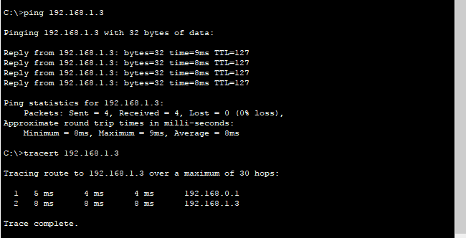
Now we are going to check our configuration using “ping” and “tracert” commands
Pinging of Server and tracing path from PC to Server

Slide 11
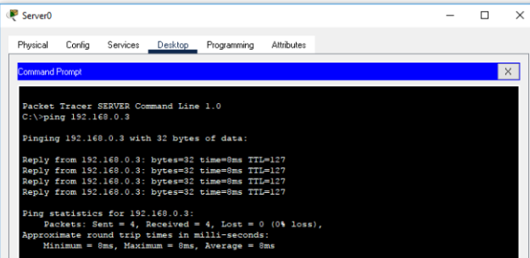
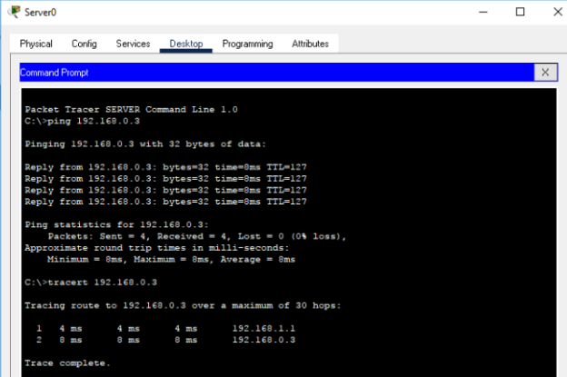
Pinging of PC and tracing path from Server to PC

Slide 12
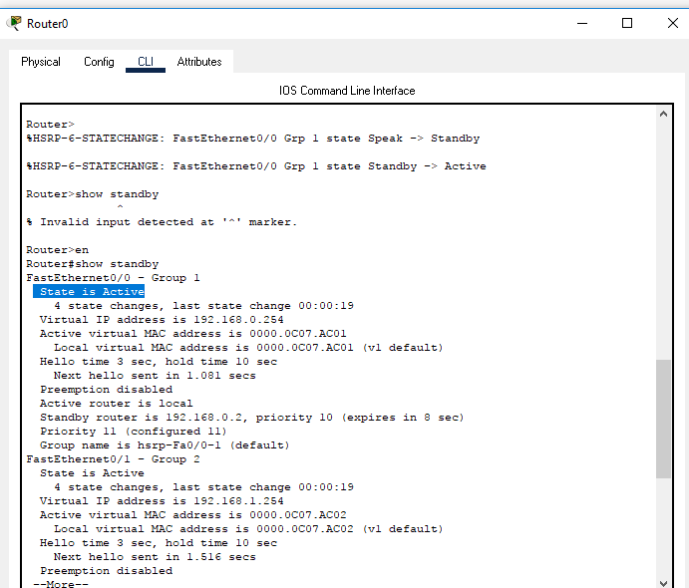
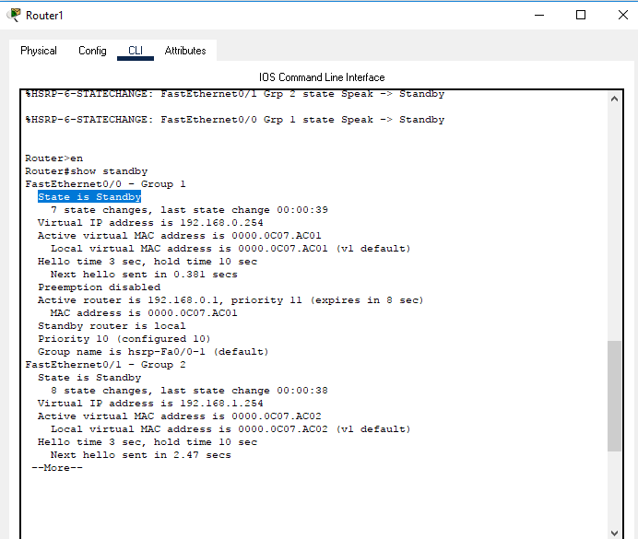
We do not need to do this HSRP Cisco Configuration for both sides, but in this configuration, we do it for both sites. After this we check the configuration with “show standby” command on GW1 and GW2. As you see below, for both redundancy configuration GW1 is the active router and the GW2 is the standby.

Slide 13
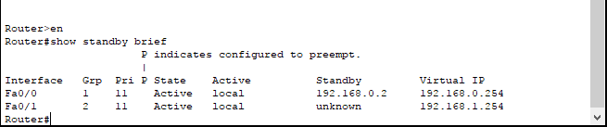
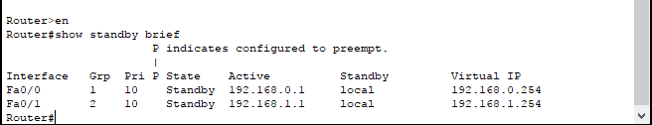
Verifying the HSRP Configuration by using “show standby brief” command

Slide 14
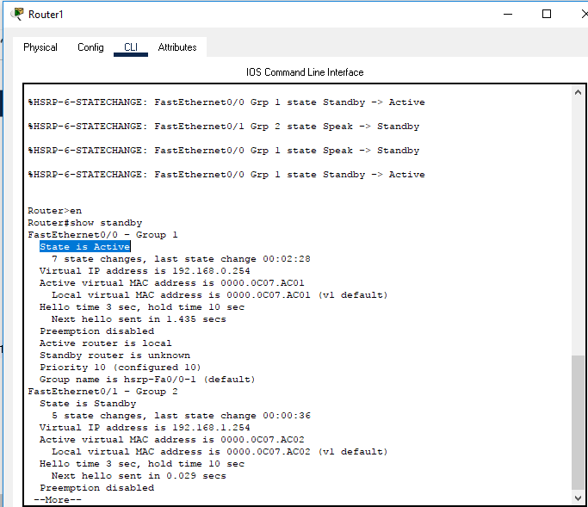
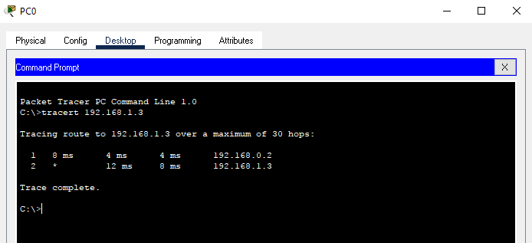
After determining the active and standby routers we then shutdown the active router and then check if the standby router becomes active or not.
As we can see from the figure below Router 1 is acting as active router now.
Then we trace the path from PC to Server and we can see that the traffic goes from Router 1 instead of Router 0.

Slide 15
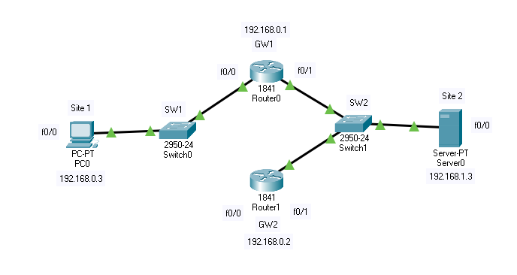
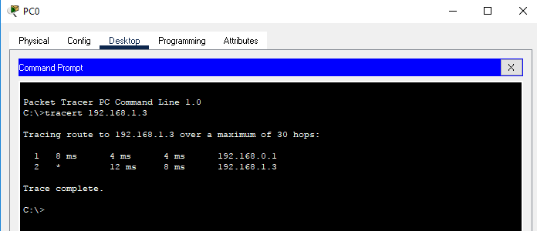
Now if we break the connection from Router 1 to switch, we can notice that the Router 0 will become active router and Router 1 will be in Init (interface down) state. If we trace the path from PC to Server then the traffic will go from Router 0.

